Slide 1
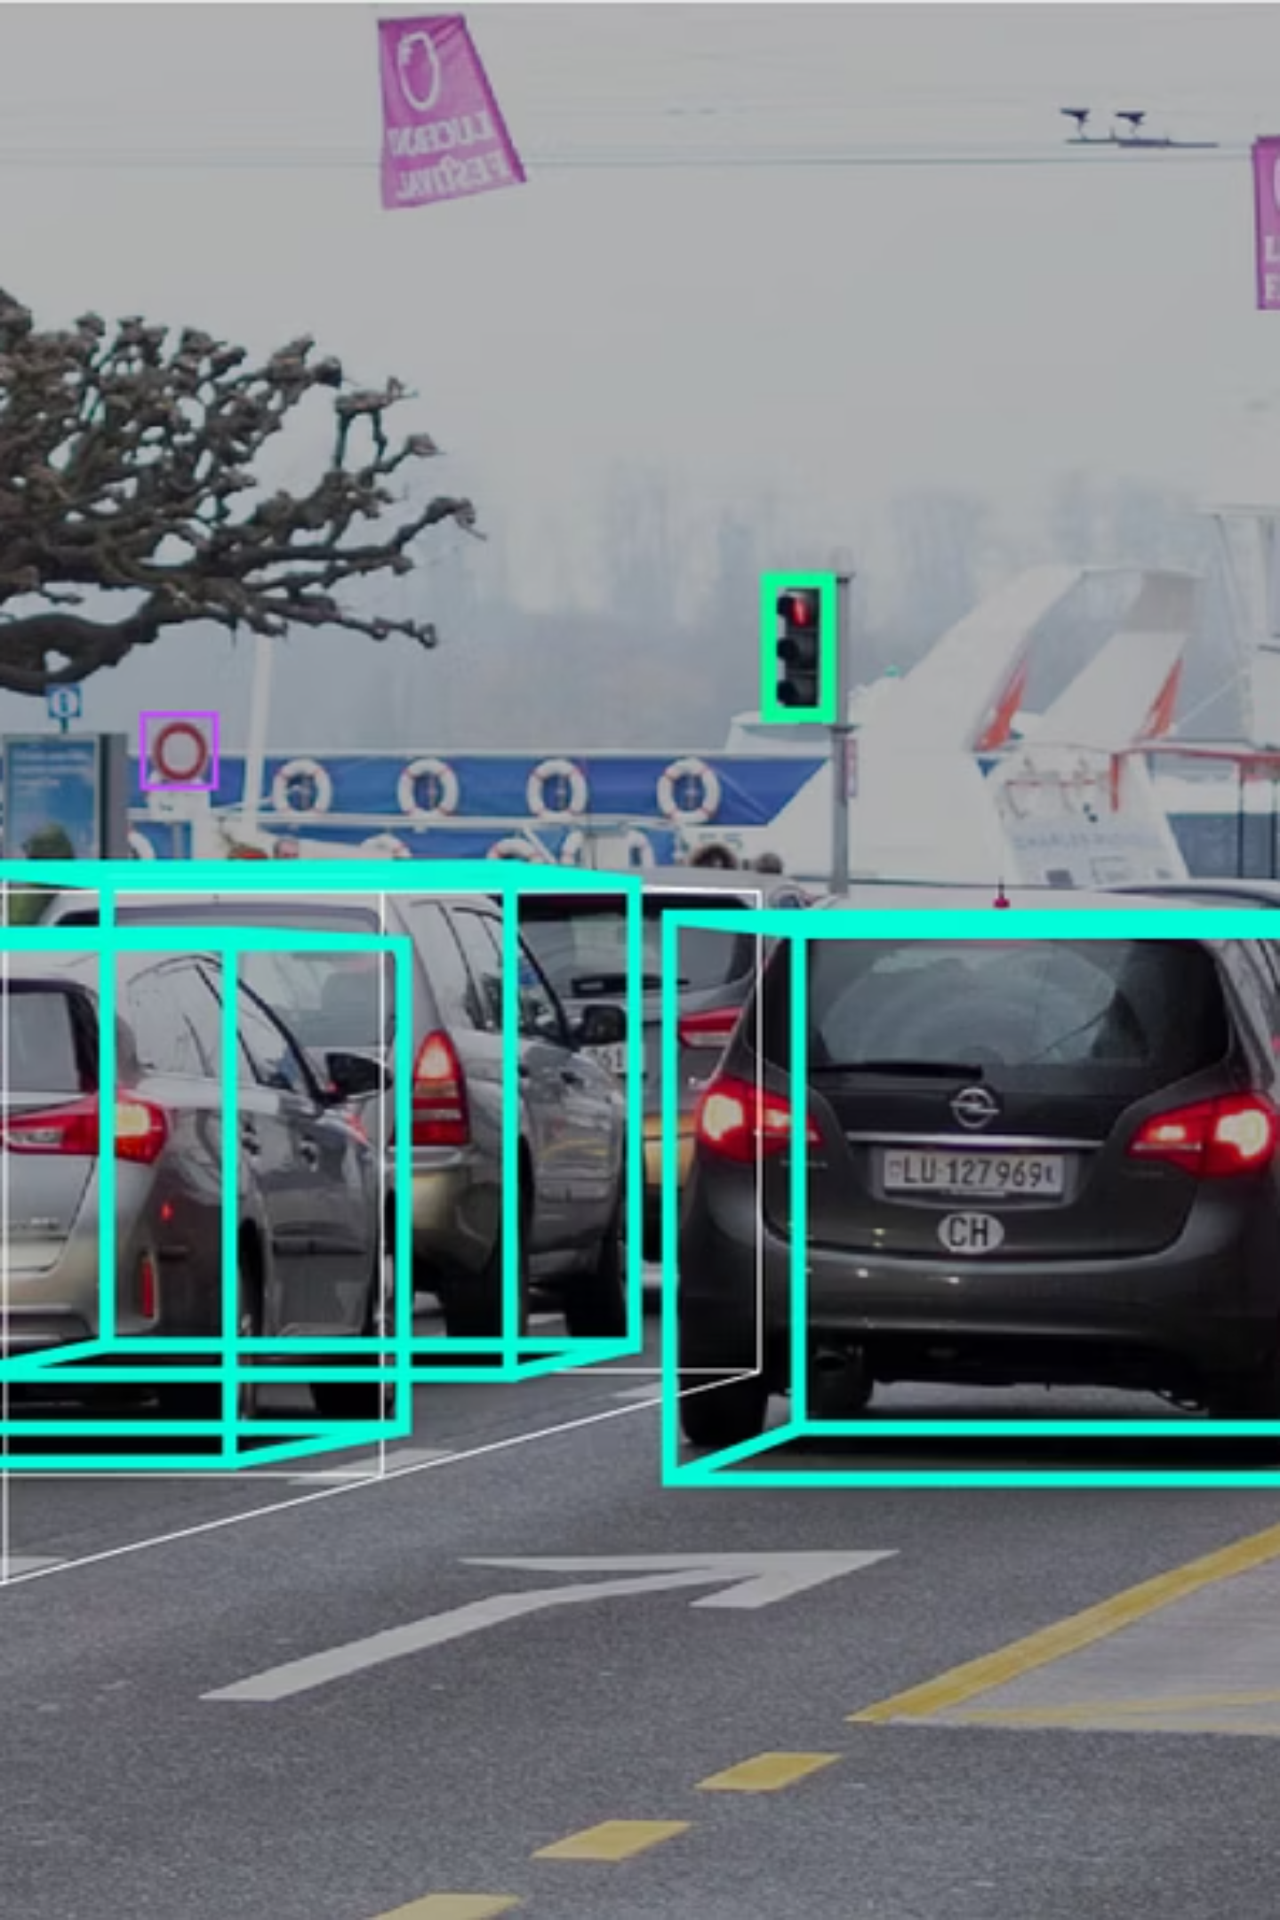
Real-time vehicle and pedestrian detection
Developing a robust, real‑time detection system to improve road safety and reduce pedestrian‑vehicle collisions in dense urban environments. System targets live alerts, accurate localization, and lightweight deployment for in‑vehicle and roadside units.

Slide 2
Problem background
The system has four core goals:
Enhance driver awareness by detecting pedestrians and nearby vehicles in real time.
Reduce accident risk via distance‑based warnings and prioritized alerts.
Deliver a lightweight, deployable solution using deep learning optimized for real‑time inference.
Provide a foundation for ITS research and autonomous driving assistance modules.

Slide 3



Baseline approach
Design and implement a real‑time detection pipeline combining:
Detector
YOLOv9 for high‑speed object detection with class and bbox outputs.
Distance Estimation
Monocular pinhole model for per‑object distance approximations.
Alerts
Distance thresholds generate prioritized driver warnings and logging.

Slide 4



Baseline model: YOLOv9 — do we really need to fine‑tune it?
Domain adaptation
Learn road geometry, reflections, and low‑light
artifacts present in dashcam footage.
Class specialization
Focus on relevant road classes (person, car,
bus, truck, bike, motor) to reduce confusion.
Notes:
Fine‑tuning on driving datasets bridges the gap between generic imagery and on‑road scenarios.

Slide 5
Fine‑tuning benefits — continued
Localization gains
Reduced domain shift
Faster adaptation
Improved bounding‑box regression for small, distant, or partially occluded pedestrians — better distance inputs.
Models tuned on BDD data generalize more consistently across weather, time‑of‑day, and city scenes.
Road‑aware weights speed up transfer learning for lane detection, signage, and tracking tasks.

Slide 6
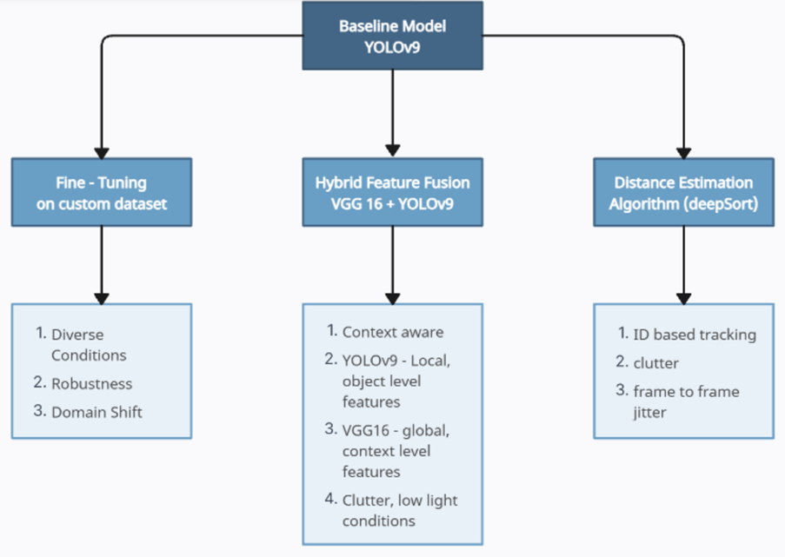
3 – Phase Approach for improving the Baseline Yolov9 model

Slide 7
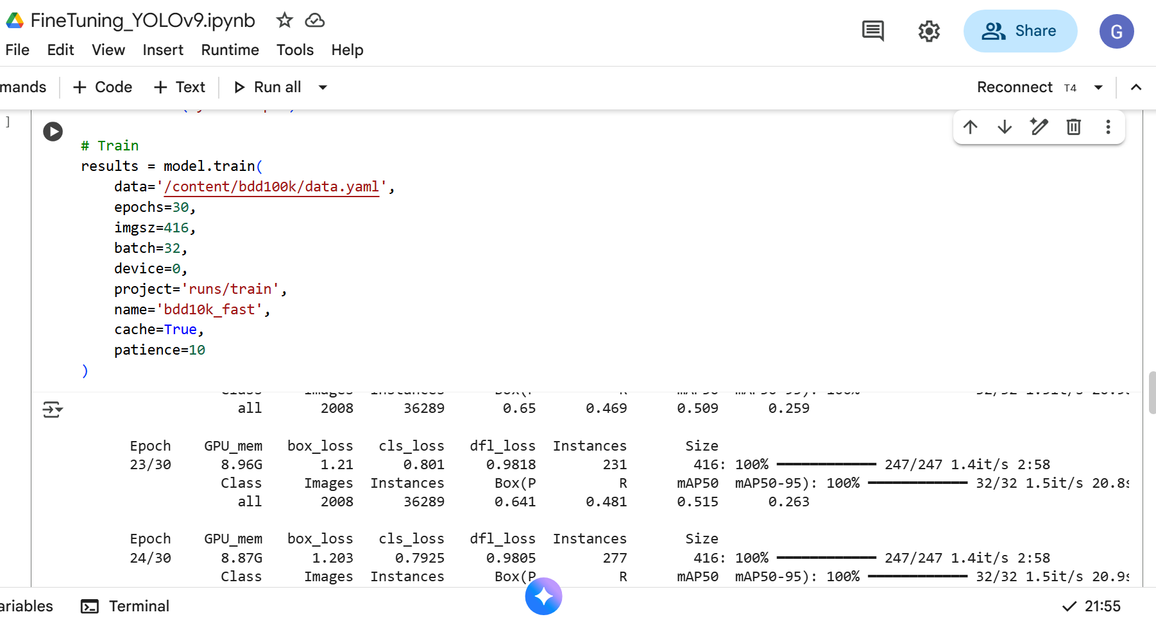
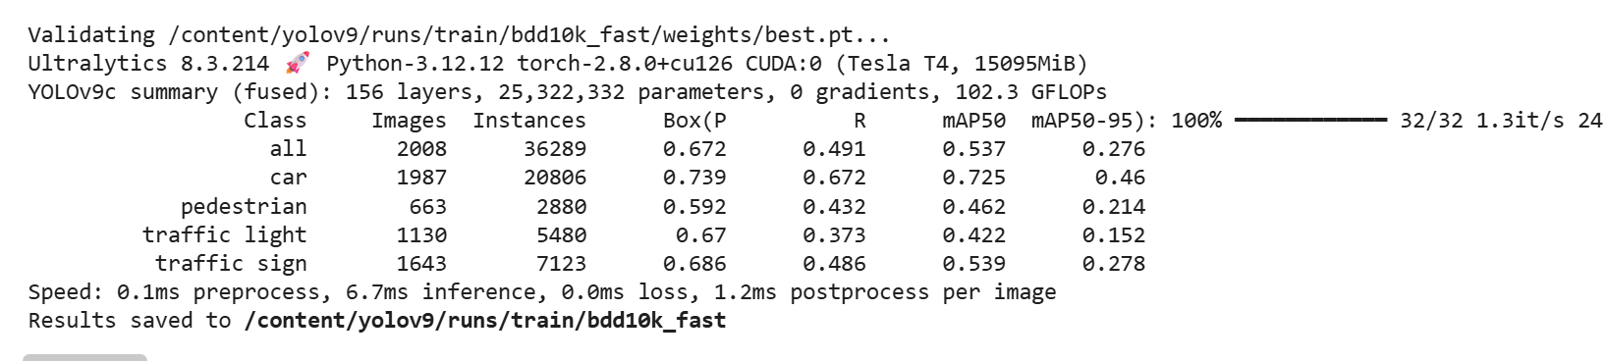
Fine tuning Yolov9 using the BDD10k Dataset
Fine tuned Model Performance:
YOLOv9: mAP50 = 53.7% on BDD10K dataset
Baseline YOLOv9: mAP50 = ~67% on COCO
Important Context:
Lower mAP50 compared to COCO baseline is expected and normal because:
BDD10K is harder - real-world driving scenarios with occlusions, weather conditions, varying distances
Different dataset - COCO has cleaner, more varied training data
Specific domain - Traffic detection is more challenging than general object detection
BDD10k’s 5 classes vs COCO's 80 classes

Slide 8
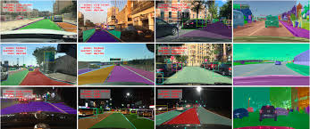
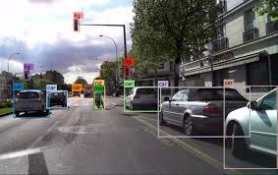
Dataset: BDD100K & BDD10K
Berkely DeepDrive datasets — curated for realistic driving scenarios and multi‑task perception.
BDD100K
BDD10K
100K dashcam videos across cities, times, and weather; supports detection, segmentation, and tracking.
10K‑image subset for practical fine‑tuning and validation with consistent annotation schema.

Slide 9
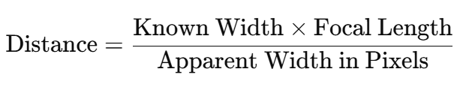
Distance estimation algorithms
Current method: monocular pinhole camera model. Assumptions and tradeoffs:
KNOWN WIDTH: real-world width of the object (meters).
FOCAL LENGTH: camera focal length in pixels.
BOX WIDTH: width of the detected object’s bounding box in pixels.
Assumptions: known real‑world width, object roughly perpendicular to camera, lens distortion is already corrected.
Pros: simple, fast, easy to implement on edge hardware.
Cons: sensitive to pose, occlusion, and inter‑subject width variation (pedestrian postures).

Slide 10




Algorithm — deepSORT tracker
Why deepSORT is a pragmatic choice for ITS:
Consistent tracking
Occlusion handling
Maintains identity across frames enabling
stable distance and speed estimates.
Re‑identifies objects after short losses
using motion + appearance features.
Real‑time ready
Enables analytics
Efficient Kalman filter + lightweight CNN
embeddings suitable for live monitoring.
Supports trajectory, speed profiling, safety‑zone violation detection, and per‑object smoothing.

Slide 11


Next steps — Improvements
Integrate front‑end UI and back‑end pipeline to stabilize frame ingestion and buffer handling, improving the speed and efficiency
Benchmark alternate distance estimators like deepSORT and quantify error vs range.
Iterate 3 - phase plan for improving the model accuracy over and above the baseline model

